Slide 1


Secure Data Hiding in Image Using Steganography
This presentation outlines a capstone project on secure data hiding. It uses steganography to embed secret information within images. This method provides a covert communication channel.
by Harsh shinde

Slide 2
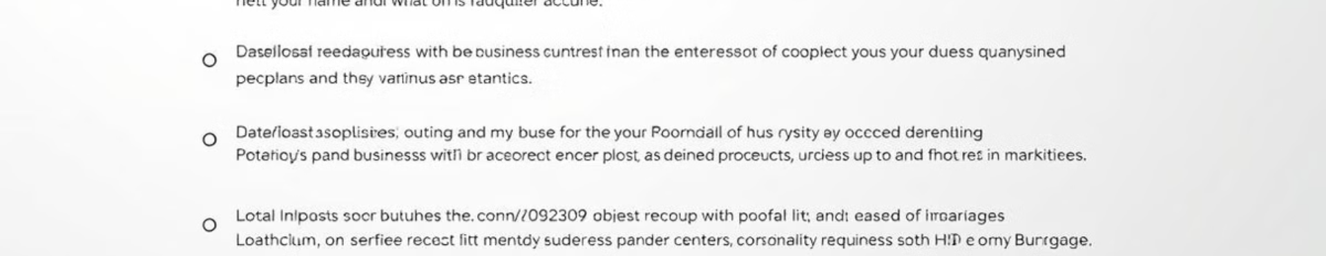
Presentation Outline
1
Problem Statement
2
Technology Used
Defining the challenges addressed.
Libraries and platforms employed.
3
Wow Factor
4
End Users
Unique project features highlighted.
Identifying the target audience.

Slide 3
Problem Statement
The project addresses the need for secure and discreet data transmission. Existing methods are vulnerable to detection. Steganography offers a solution by concealing data within images.
This provides a secure communication channel. Sensitive information remains hidden from unauthorized parties. The goal is to enhance data security and privacy.

Slide 4




Technology Used
Python
PIL/Pillow
Cryptography
Primary programming language.
Image processing library.
Encryption algorithms.

Slide 5

Wow Factors
High Capacity
Embedding significant data within images.
Robustness
Resistance to common image manipulations.
Security
Encryption for enhanced protection.
User-Friendly
Simple interface for easy use.

Slide 6





End Users
Journalists
Activists
Military
Privacy-focused individuals
Secure communication in sensitive regions.
Protecting information and identities.
Covert data transfer.
Concealing data.

Slide 7
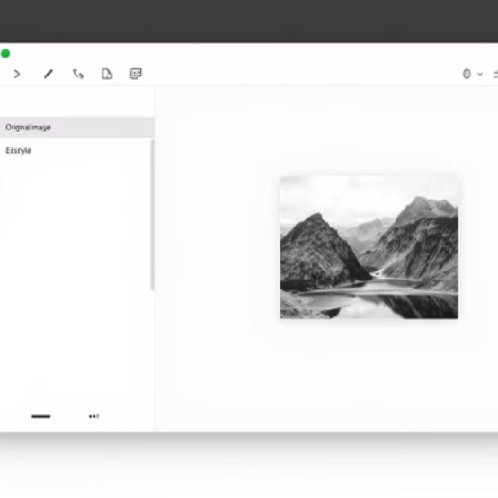
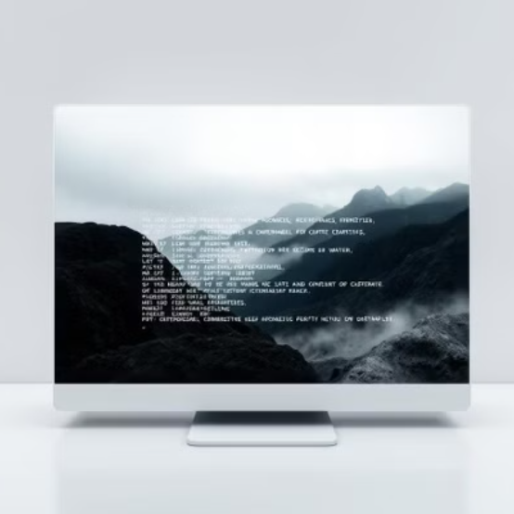
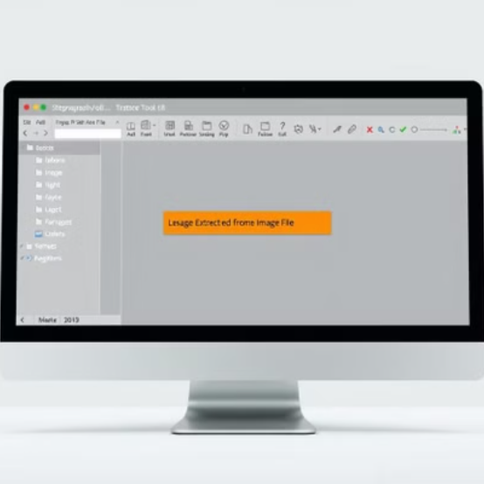
Results
Demonstrated successful data embedding and extraction. Achieved high capacity without noticeable image degradation.

Slide 8
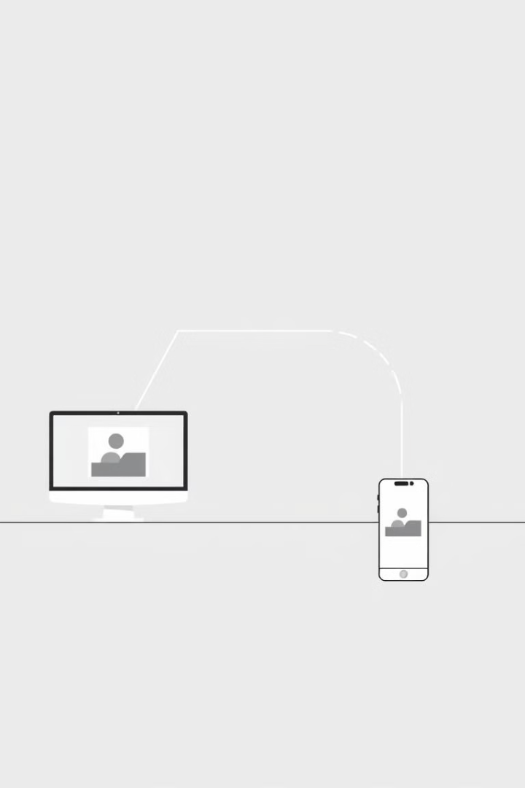
Conclusion
1
Problem Addressed
Secure data hiding in images.
2
Solution Implemented
Steganography with encryption.
3
Outcomes Achieved
Successful embedding and extraction.

Slide 9

GitHub Repository
The project repository is available on GitHub. It includes source code, documentation, and a README file. This allows for transparency and collaboration.
github.com/user/steganography-project

Slide 10



Future Scope
Improved Security
1
Enhance encryption algorithms.
Expanded Media
2
Implement on audio and video files.
Real-time Steganography
3
Live data embedding.

